Slide 1
TREES!

Slide 2
Instructor
Dr. Ab Rouf Khan
Assistant Professor
VIT Bhopal University

Slide 3
Entry level Questions
How does Google sort the webpages while you are searching for some query?
How is hierarchical information stored in a database?
Can we perform sorting using Tree data structure?

Slide 4
Outline (Module 4 [Part 1])
Linear versus Non-Linear Data Structures
Tree Data Structure
Terminologies
Binary Tree
Expression Tree
Tree Traversals
Binary Search Tree
AVL Tree
Red black Tree
Splay Tree
B Tree.

Slide 5
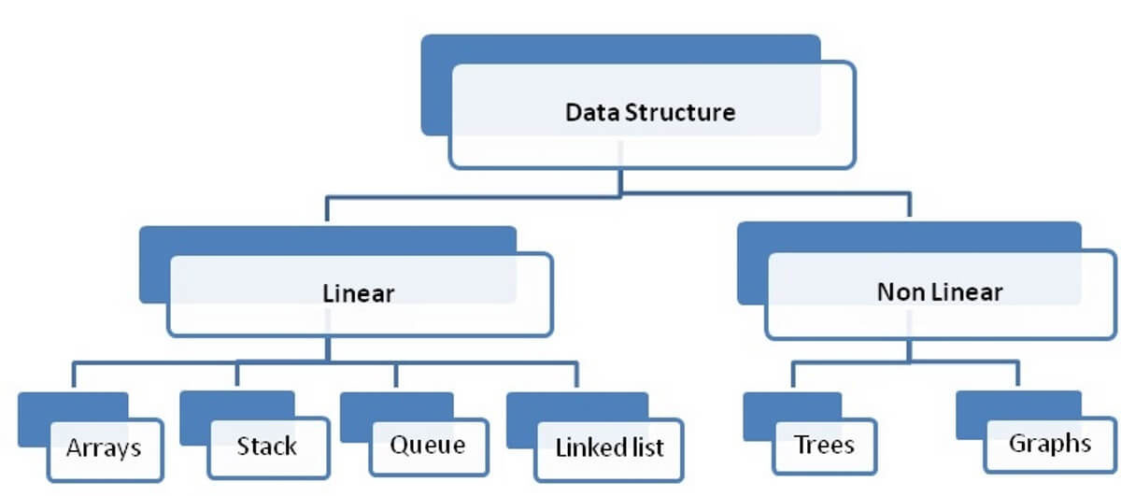
Linear vs Non-Linear Data Structures – Classification

Slide 6
Linear vs Non-Linear Data Structures – Comparison
Basis for comparison | Linear Data Structure | Non-Linear Data Structure
Basic | The data items are arranged in an orderly manner where the elements are attached adjacently. | It arranges the data in a sorted order and there exists a relationship between the data elements.
Traversing of the data | The data elements can be accessed in one time (single run). | Traversing of data elements in one go is not possible.
Ease of implementation | Simpler | Complex
Levels involved | Single | Multiple Level
Memory utilization | Effective | Ineffective
Examples | Array, queue, stack, linked list, etc. | Trees and Graph

Slide 7







Trees!

Slide 8
Nature’s View of Trees
Leaves
Branches
Root

Slide 9

A Computer Scientist’s View of Trees
Root
Leaves
Branches
Nodes
Notes:
Branches meet at nodes.

Slide 10
Linear Lists and Trees
Linear lists are useful for serially ordered data.
(e₀, e₁, e₂, …, e_{n-1})
Days of week.
Months in a year.
Students in this class.
Trees are useful for hierarchically ordered data.
Employees of a corporation.
President, vice presidents, managers, and so on.
Java’s classes.
Object is at the top of the hierarchy.
Subclasses of Object are next, and so on.

Slide 11
Hierarchical Data And Trees
The element at the top of the hierarchy is the root.
Elements next in the hierarchy are the children of the root.
Elements next in the hierarchy are the grandchildren of the root, and so on.
Elements that have no children are leaves.

Slide 12
Tree - Definition
A tree t is a finite nonempty set of elements.
One of these elements is called the root.
The remaining elements, if any, are partitioned into trees, which are called the subtrees of t.

Slide 13
Tree – Datastructure
Fundamental data storage structures used in programming.
Combines advantages of an ordered array and a linked list.
Searching as fast as in ordered array.
Insertion and deletion as fast as in linked list

Slide 14
Tree - Terminology
A tree is a collection of elements (nodes)
Each node may have 0 or more successors
(Unlike a list, which has 0 or 1 successor)
Each node has exactly one predecessor
Except the starting / top node, called the root
Links from node to its successors are called branches
Successors of a node are called its children
Predecessor of a node is called its parent
Nodes with same parent are siblings
Nodes with no children are called leaves

Slide 15
Why Tree?
Faster than linear data structures
More natural fit for some kinds of data
Examples?

Slide 16
Example Tree
root
Rouf’s Home Page
Teaching
Research
Activities
CSE2002
CSE2004
Papers
Presentations

Slide 17
Tree Terminology (1)
Subtree of a node:
A tree whose root is a child of that node
Level of a node:
A measure of its distance from the root:
Level of the root = 1
Level of other nodes = 1 + level of parent

Slide 18
Subtrees
Object
root
Subtree 1
Number
Throwable
OutputStream
Subtree 3
Integer
Double
Exception
FileOutputStream
RuntimeException

Slide 19
Leaves
Object
Number
Throwable
OutputStream
Leaves
Integer
Double
Exception
FileOutputStream
RuntimeException

Slide 20
Levels
Object
Level 1
Number
Throwable
OutputStream
Level 2
Integer
Double
Exception
FileOutputStream
Level 3
RuntimeException
Level 4

Slide 21
Be Cautious regarding the Level numbers
Some texts start level numbers at 0 rather than at 1.
Root is at level 0.
Its children are at level 1.
The grand children of the root are at level 2.
And so on.
We shall number levels with the root at level 1.

Slide 22
height = depth = number of levels
Depth/Height of the given Tree starting from Root = 4
Object
Level 1
Level 2
Number
Throwable
OutputStream
Integer
Double
Exception
FileOutputStream
Level 3
RuntimeException
Level 4

Slide 23
Node-Degree = Number of Children
Object
3
2
Number
1
Throwable
1
OutputStream
0
0
1
0
Integer
Double
Exception
FileOutputStream
RuntimeException
0

Slide 24
Tree-Degree = Max Node-Degree
Object
3
2
Number
1
Throwable
1
OutputStream
0
0
1
0
Integer
Double
Exception
FileOutputStream
RuntimeException
0
Degree of tree = 3.
Notes:
Note that it is possible to have a tree whose degree is (say) 3 and whose root has a degree that is < 3.

Slide 25
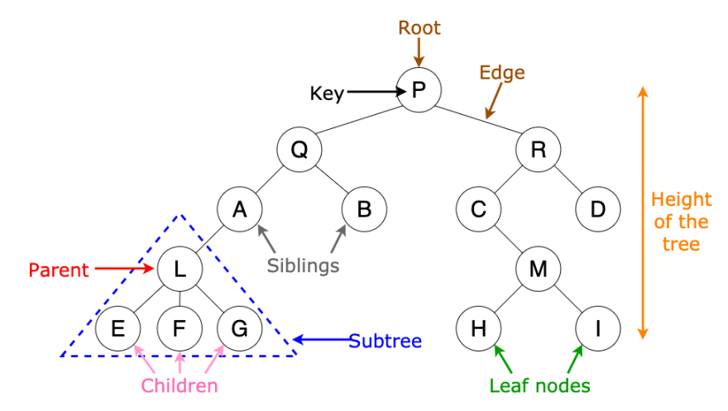
Tree – Summary

Slide 26
Binary Tree
Every node in a binary tree can have at most two children.
The two children of each node are called the left child and right child corresponding to their positions.
A node can have only a left child or only a right child or it can have no children at all.

Slide 27
Binary Tree (1)
Binary tree: a node has at most 2 non-empty subtrees
Set of nodes T is a binary tree if either of these is true:
T is empty
Root of T has two subtrees, both binary trees
(Notice that this is a recursive definition)

Slide 28
Binary Tree (2)
Finite (possibly empty) collection of elements.
A nonempty binary tree has a root element.
The remaining elements (if any) are partitioned into two binary trees.
These are called the left and right subtrees of the binary tree.

Slide 29
A Tree vs a Binary Tree
No node in a binary tree may have a degree more than 2, whereas there is no limit on the degree of a node in a tree.
A binary tree may be empty; a tree cannot be empty.

Slide 30
A Tree vs a Binary Tree (2)
The subtrees of a binary tree are ordered; those of a tree are not ordered.
a
a
b
b
Are different when viewed as binary trees.
Are the same when viewed as trees.

Slide 31
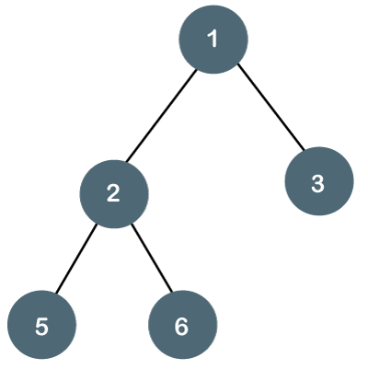
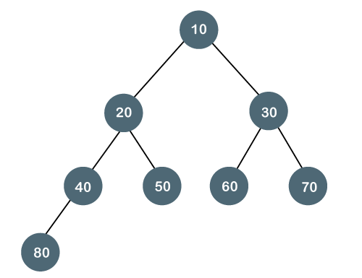
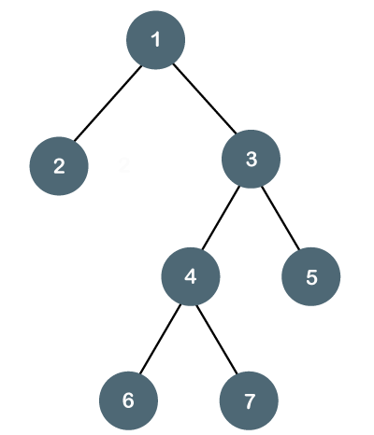
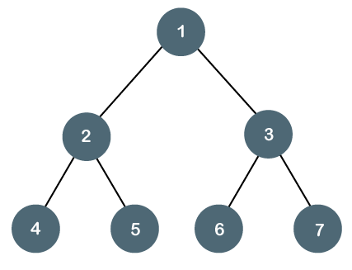
Binary Tree – Examples

Slide 32
Binary Tree – Representation
Similar to Linked List but with 2 Links
Store the nodes at unrelated locations in memory and connect them using references in each node that point to its children.
Can also be represented as an array, with nodes in specific positions stored in corresponding positions in the array.

Slide 33
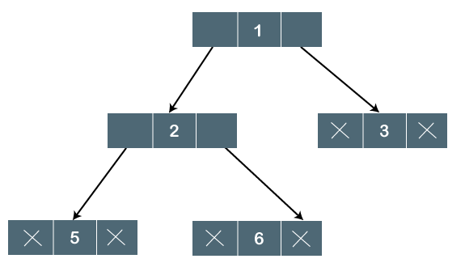
Binary Tree – Representation: Example

Slide 34
root
Binary Tree
4
1
7
NULL
-1
3
13
NULL
NULL
NULL
NULL
NULL
NULL
(i) pointer to left child node
(ii)
data
(iii) pointer to right child node
Each node has 3 fields
Defining Binary Tree and declaring it
Three types of nodes
Root node
Internal nodes
Leaf nodes (left and right subtrees are NULL)
typedef struct _btnode *Btree;
struct _btnode {
int data;
Btree left;
Btree right;
};
Btree root;

Slide 35
Binary Tree – Representation: Objects with Links
Btree
Btree
Int data
Btree left_chid
Btree right_child
Int data
Btree left_chid
Btree right_child
Find()
Insert()
Delete()
Find()
Insert()
Delete()
Btree
Btree
Int data
Btree left_chid
Btree right_child
Int data
Btree left_chid
Btree right_child
Find()
Insert()
Delete()
Find()
Insert()
Delete()

Slide 36
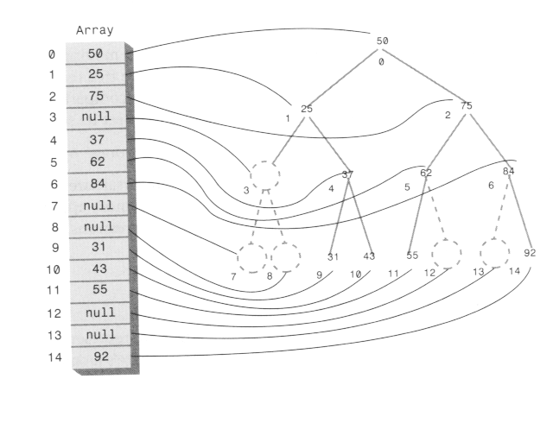
Binary Tree – Representation: Array

Slide 37

Recap

Slide 38
Thank You

